Slide 1
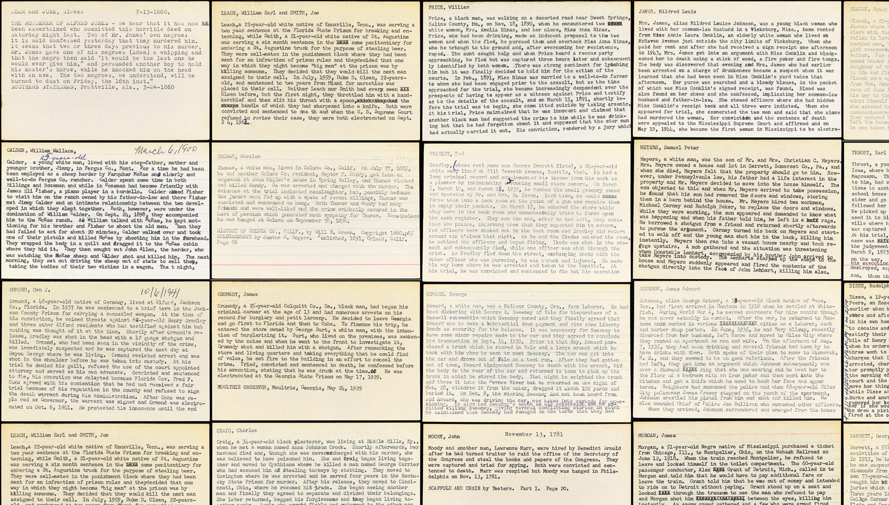
Challenges and Conflicts of Linked Data in Archives
Gregory Wiedeman, @GregWiedeman
University at Albany, SUNY
SAA 2018 Session 303

Slide 2


The Espy Project
Collected documentation on American executions 1608-2002
Index card summaries, 46 cu. ft. copies of original and published source material
1980s NSF grant to create “The Espy File” now in ICPSR
Main source for historical research on Capital Punishment in America
Blackman and McLaughlin, “The Espy File on American Executions: User Beware” (2011)
Current CLIR grant to digitize and provide computational access to collection

Slide 3
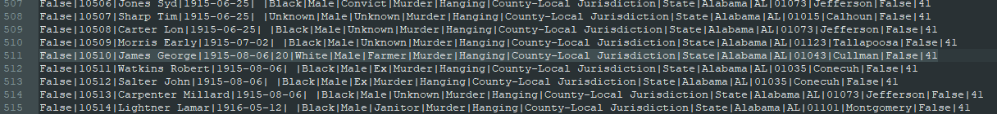
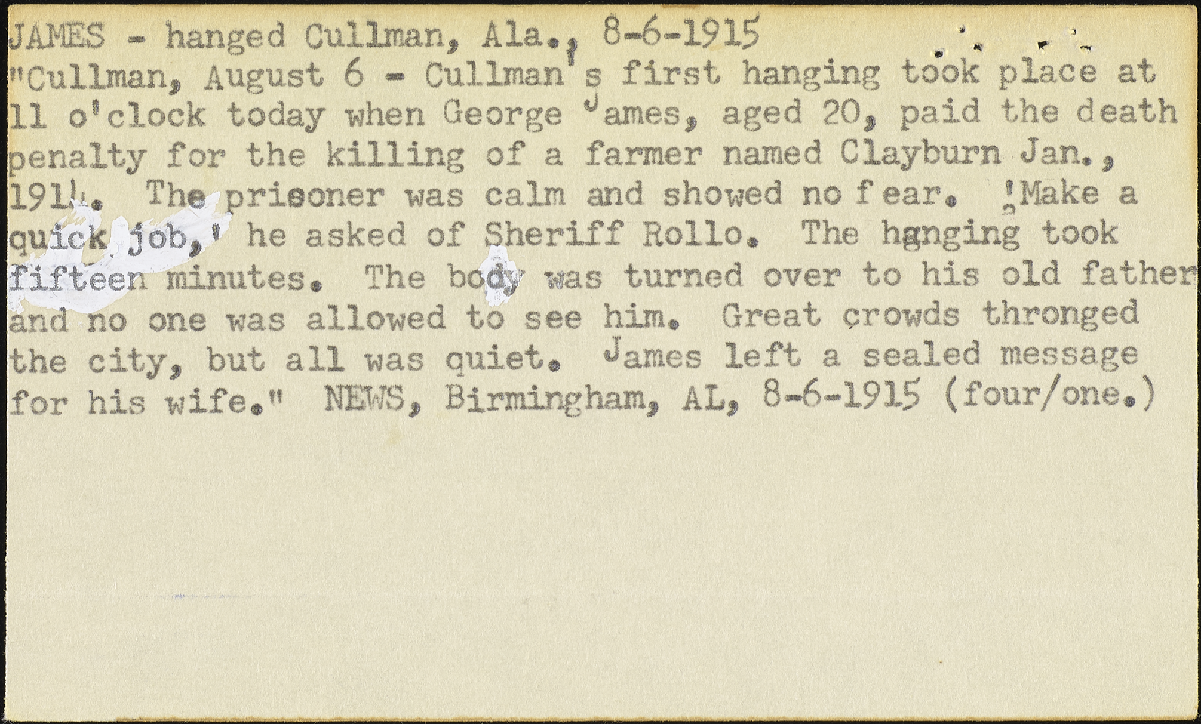
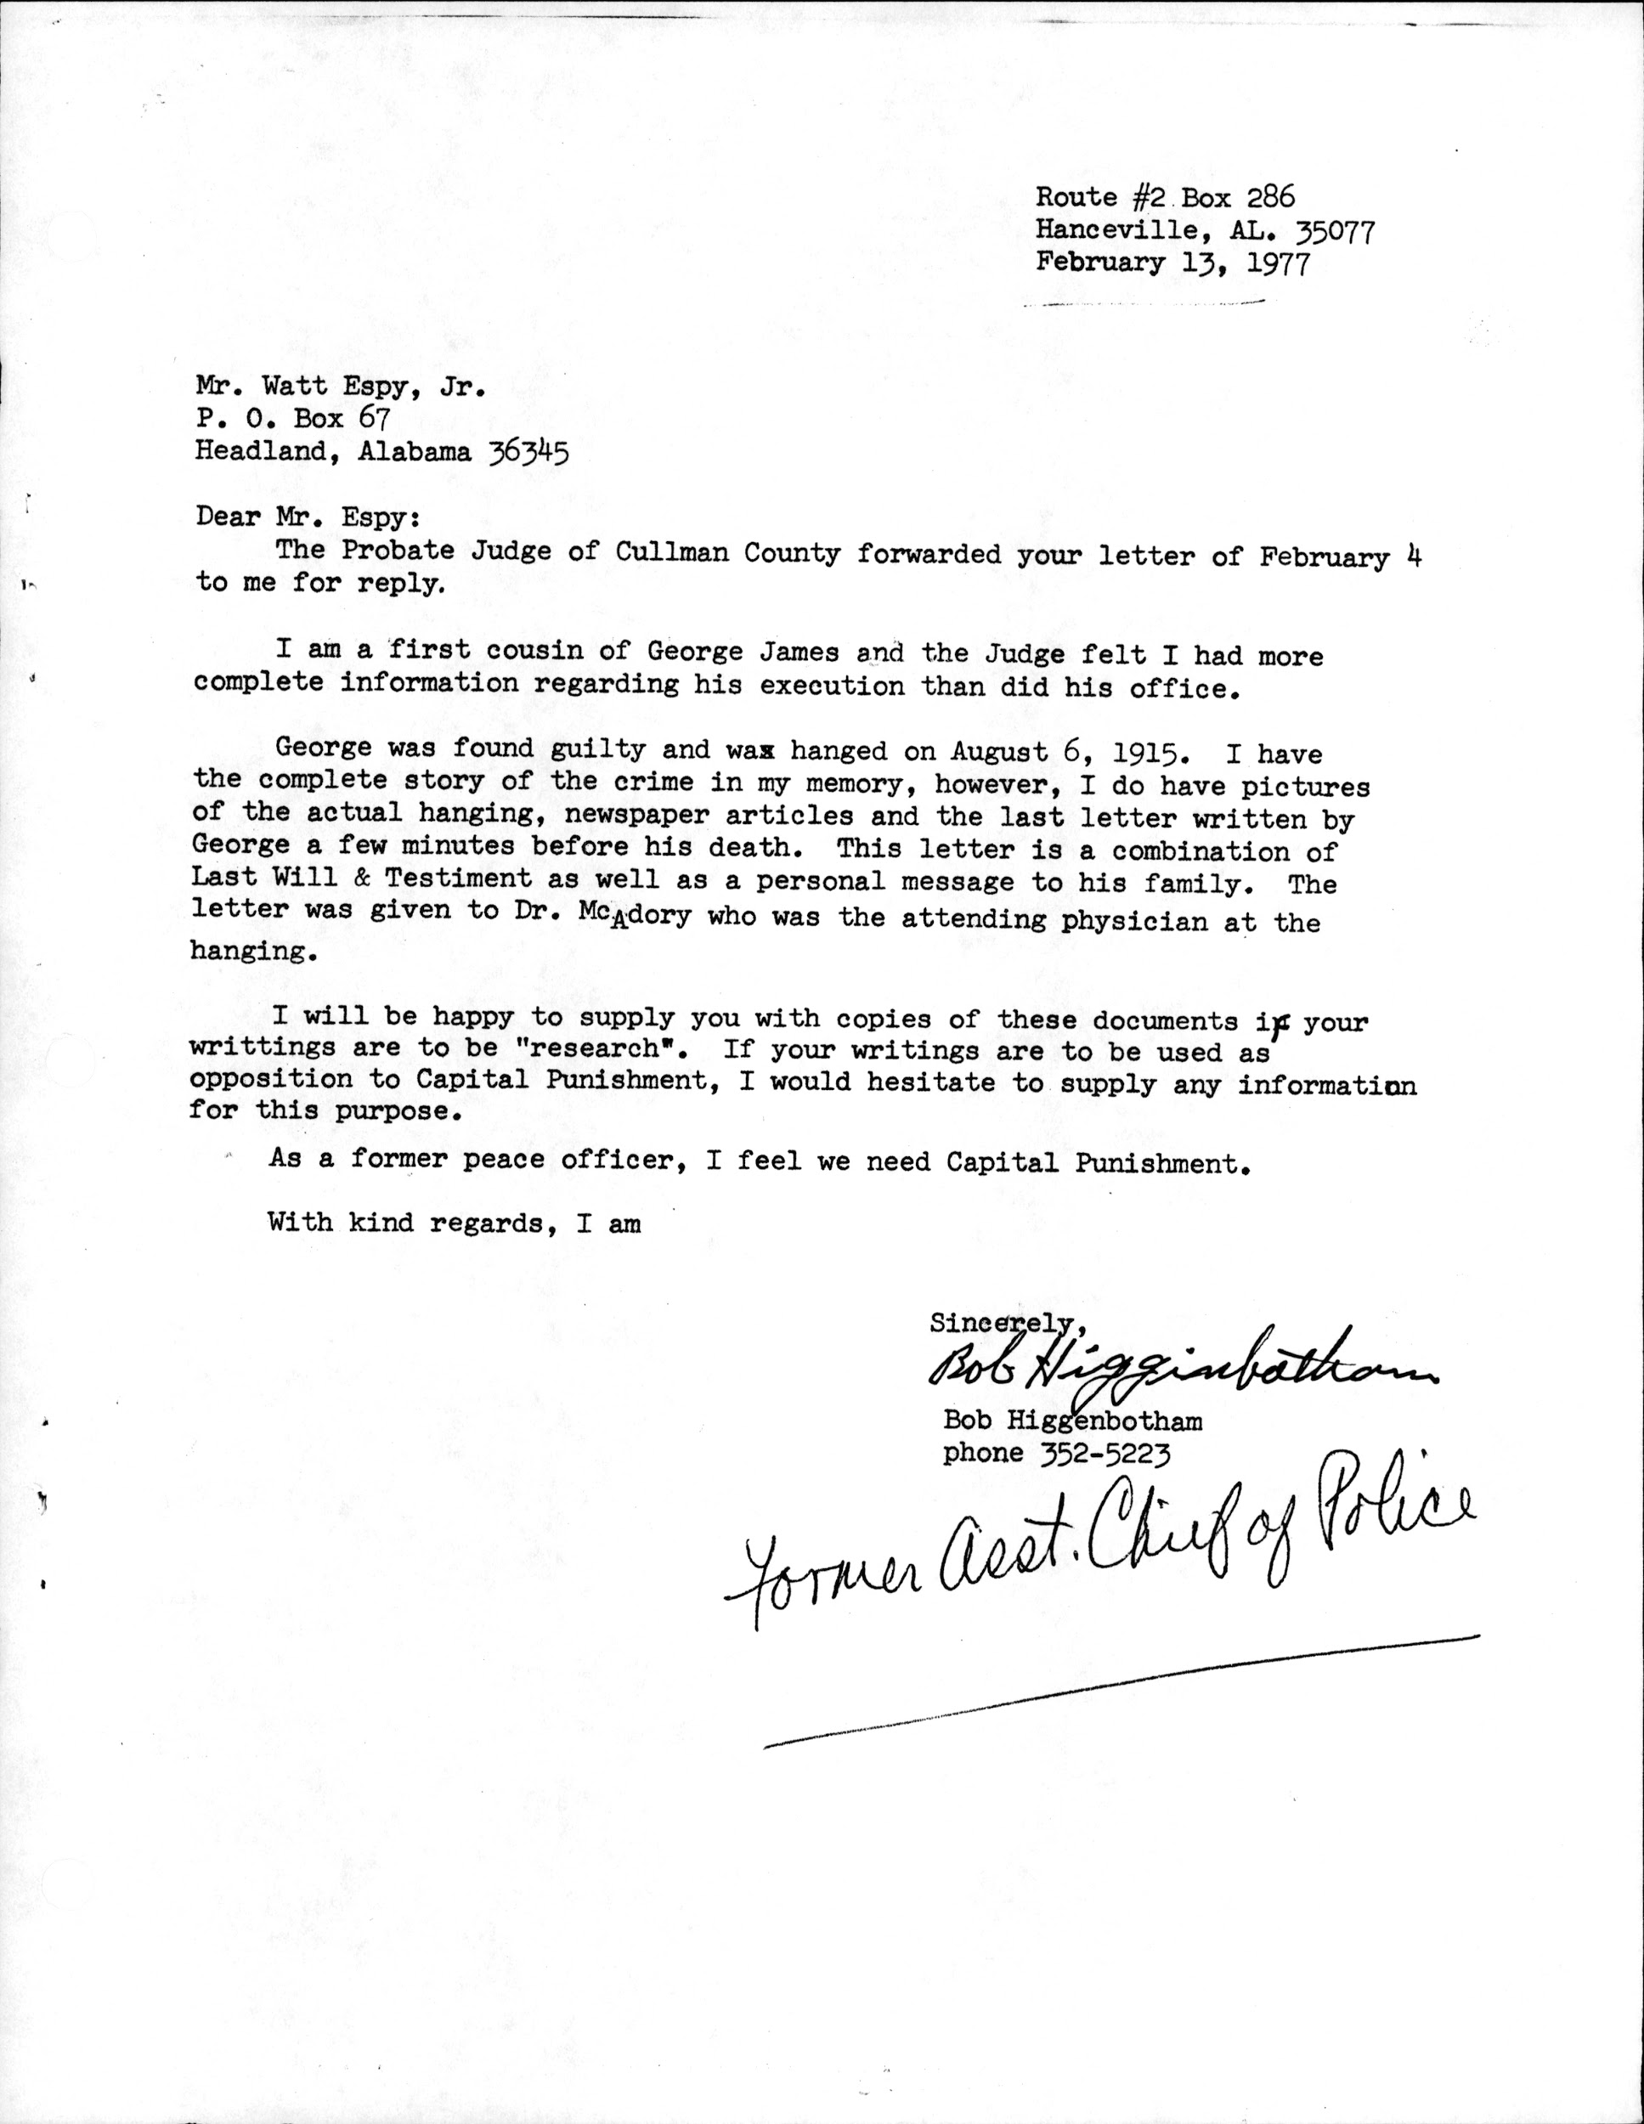

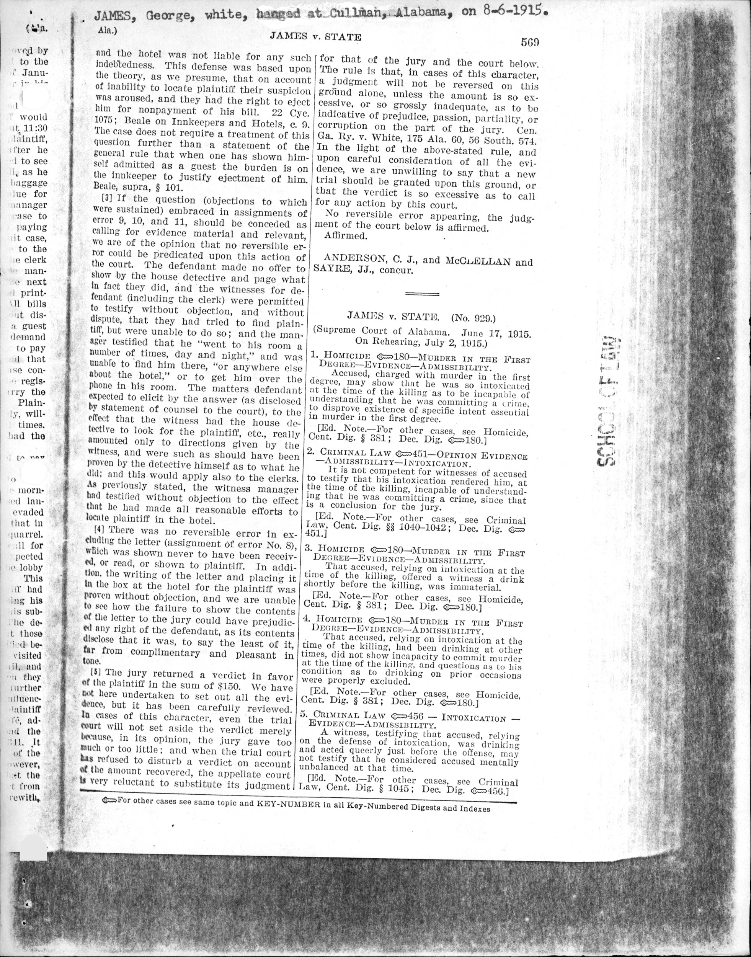
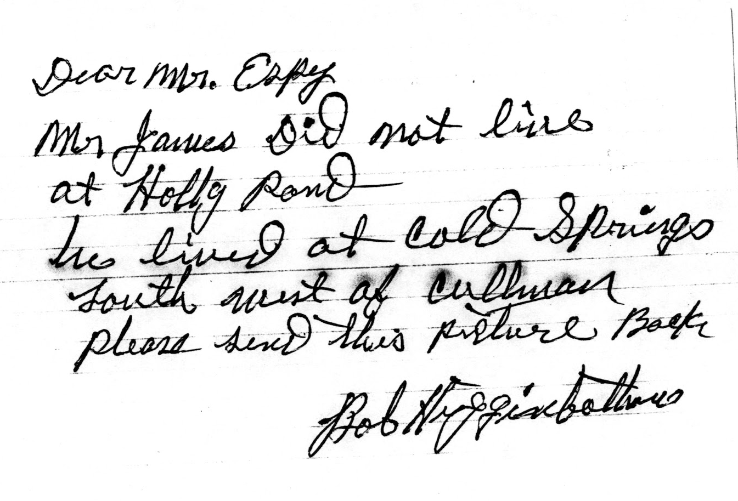
Exposing Data, Providing Context

Slide 4
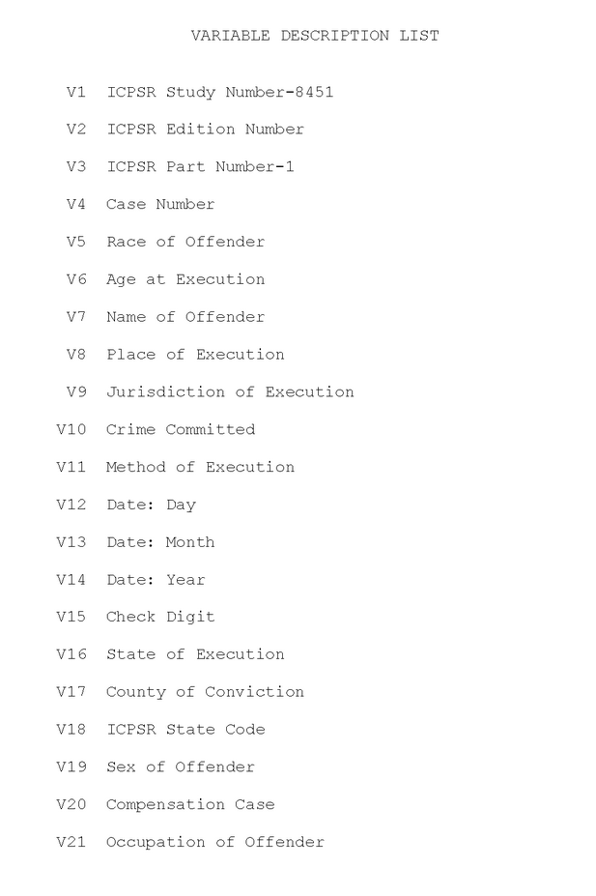
Metadata Matters
Occupation Field
“Student"
"Banana Dealer"
"Beef Carrier"
"Goat Herder"
"Tiecutter"
"Tourist"
"Armed robber"
"Asylum Escapee"
"Bandit"
"Criminal"
"Cult Leader"
"Gang Member"
"Lunatic"
"Male Nurse"
"Retarded"
"Slave"
“Crime Convicted of” not “Crime Committed”
Found that precision was often problematic in LOD vocabularies
Create our own vocabulary?

Slide 5
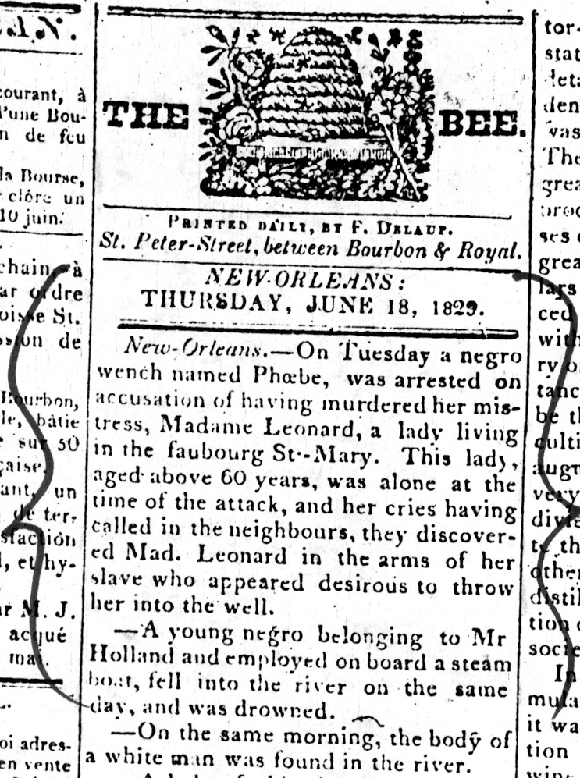
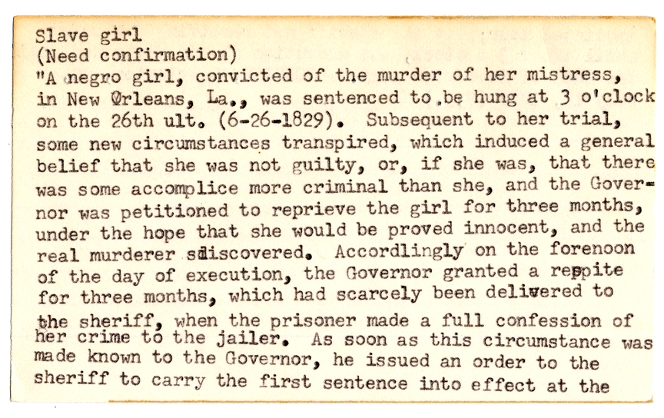
Exposing Data in Context

Slide 6
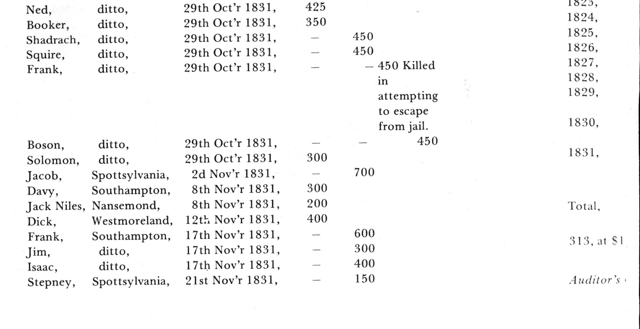
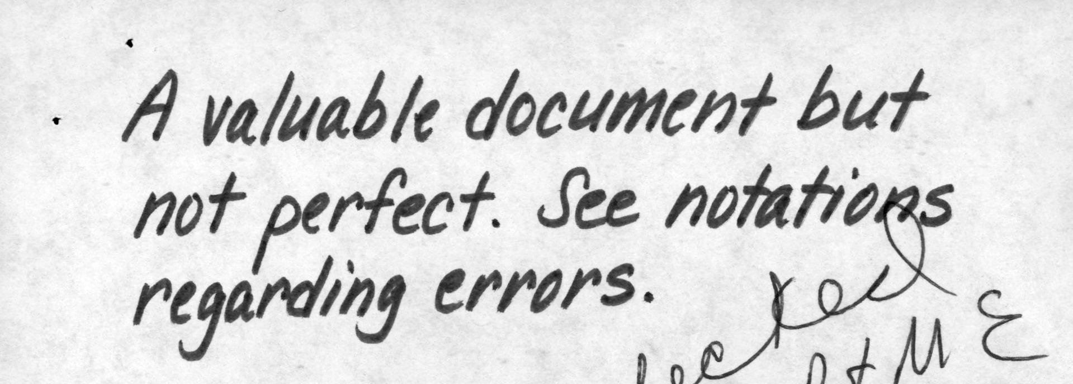
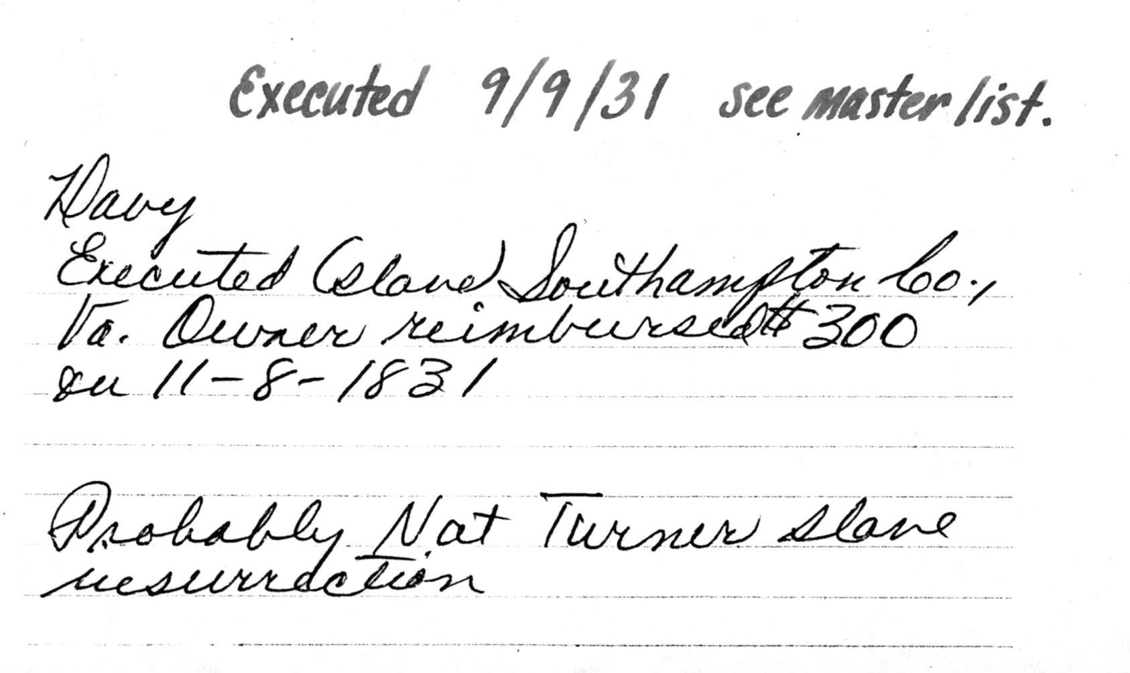
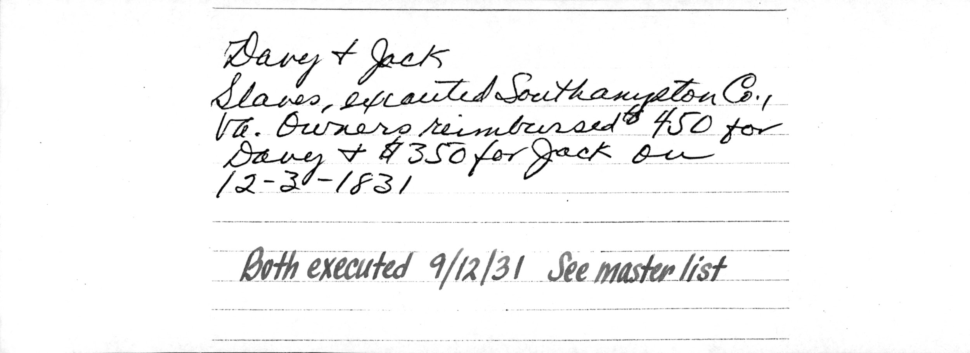
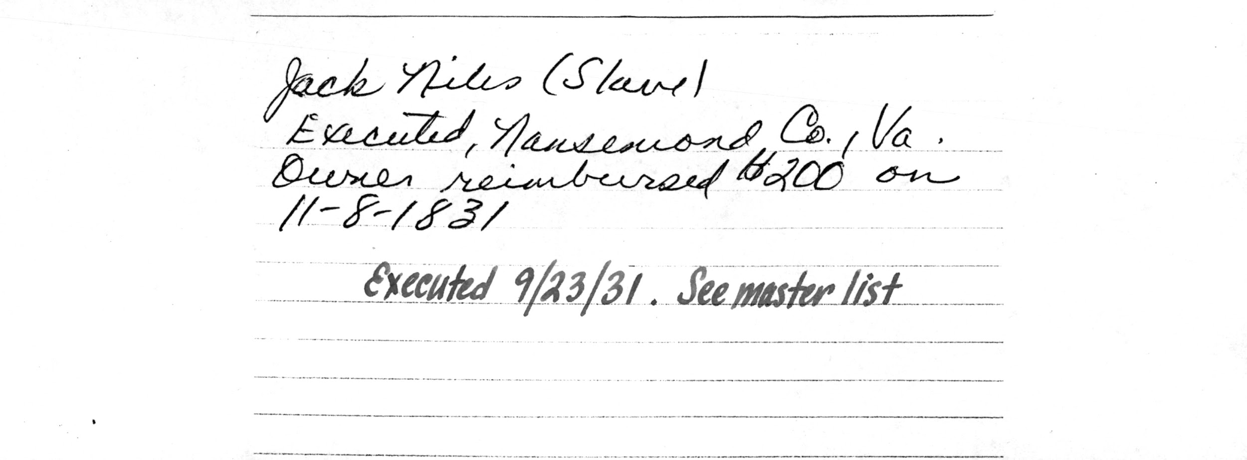

Slide 7
Does Linked Data align with the Archival Mission?
Archives use context to efficiently provide access to unique material at scale
Researchers will not use SPARQL to access this data
In practice, do URIs provide or obscure context?
Does a Linked Data URI convey false objectivity or false authority?
Does this scale?
As we start seeing archival collections themselves as data, Linked Data may not be a good fit

Slide 8
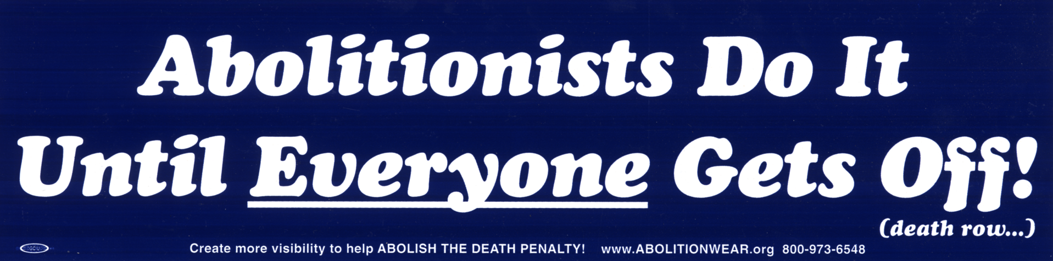
Challenges and Conflicts of Linked Data in Archives
Gregory Wiedeman, @GregWiedeman
University at Albany, SUNY
SAA 2018 Session 303

